Slide 1

GOKARAJU RANGARAJU INSTITUTE OF ENGINEERING AND TECHNOLOGY Department of Computer Science and Engineering Mini Project Review-2
MoneyMitra - Every penny has purpose
Under the esteemed guidance of
P Gopala Krishna
Professor
Batch No:E7
23241A05T5 - BODDU ADITHYA HARSHITH REDDY
23241A05U9 - G.MANIDEEP
23241A05V0 - HARIVARDHAN.K
23241A05X6 - RISHWIK REDDY RAYALAPURAM

Slide 2
ABSTRACT
Money Mitra is an intelligent, AI-powered financial assistance platform designed to support users in effective financial planning, expense tracking, and informed decision-making. The system integrates transaction management through manual entry, receipt scanning (OCR), and automatic notification-based capture, along with budgeting, goal-based savings, loan management, AI-driven loan eligibility prediction, and chit fund management into a unified application. Users can track income and expenses across multiple accounts such as bank, UPI, and cash, set monthly budgets, and automatically save surplus amounts toward financial goals. The platform also evaluates loan eligibility using machine learning models, providing risk analysis, approval predictions, and actionable recommendations with explainable insights. Additionally, it enables efficient chit fund tracking by managing members, contributions, and payouts. By combining automation, data-driven intelligence, and user-friendly guidance, Money Mitra bridges the gap between financial awareness and actionable planning, making it especially beneficial for students, salaried individuals, and first-time borrowers.

Slide 3
PROBLEM STATEMENT
Introduction
Managing personal finances is challenging due to rising expenses and limited financial awareness, while existing apps focus only on basic tracking and budgeting. Many users lack integrated tools for intelligent transaction tracking, goal planning, and loan evaluation. Money Mitra is an AI-powered platform that combines transaction management (manual, OCR, and auto notification capture), budgeting, goal-based savings, loan prediction, and chit fund management, enabling users to make informed financial decisions through automated insights.
Existing System & Limitations
• Focus only on expense tracking and basic budgeting
• No AI-based loan eligibility prediction or risk analysis
• Lack of automated insights and financial recommendations
• No support for auto-reading notifications for transaction capture
• No support for goal-based savings with automation
• Absence of chit fund management features

Slide 4
Existing Approaches (Literature Survey)
Ref. No.​ | Title of the Paper & Year | Authors | Methodology / Approach | Observed Gaps / Limitations
[1] ​ | Student Expense Tracking System Using OCR (2025) | Ahmad Fad)li Saad, Muhammad Hairil Shaharudin, Achmad Yani, Abdi Manaf, Andi Almeira Zocha Ismail, Andi Regica Acacia Ismail | Developed a web-based expense tracking system using Optical Character Recognition (OCR) to automatically extract expense details from scanned receipts. The system follows Website Development Life Cycle (WDLC), stores data in a database, provides budget setting, expense categorization, and visual analytics (charts & graphs). Usability was evaluated using PSSUQ with 30 students. | The existing system focuses mainly on basic expense tracking and lacks key features such as auto-read notification-based transaction capture, AI-driven forecasting, goal-based savings automation, loan prediction, and chit fund management, limiting effective financial planning.
[2]​ | AI-Powered Personal Finance Assistant For Intelligent Expense Tracking And Budget Optimization (2025) | Dr. A.K. Ashfauk Ahamed1, S K S Ahamed Shahif2 | An AI-based approach combining OCR, SMS parsing, machine learning, and an NLP chatbot is used to automate expense tracking and budget optimization through a React Native frontend and Firebase backend. | The system mainly focuses on expense tracking and budgeting and lacks support for goal-based planning, time-bound savings estimation, AI-driven loan eligibility prediction, loan recommendations, and document-related assistance, limiting effective financial planning.

Slide 5
Existing Approaches (Literature Survey)
Ref. No.​ | Title of the Paper & Year | Authors | Methodology / Approach | Observed Gaps / Limitations
[3] ​ | Review Paper on Money Manager(2025) | Y. D. Nagvekar, Bhosale Maithili Mangesh, Bogati Jayanti Suresh, Chaudhary Pranjal Subhash | The system provides a simple money management solution where users can record income and expenses, categorize transactions, set monthly budgets, track savings goals, and analyze spending using basic visual reports. | The system supports only basic financial tracking and budgeting and lacks intelligent features such as AI-based loan eligibility prediction, personalized recommendations, document guidance and verification, time-based goal planning, and auto-read notification-based transaction capture.
[4]​ | Smart Expense Tracking System Using Machine Learning (2023) | S. Aishwarya, S. Hemalatha | An automated expense tracking system using machine learning models to collect data from bank transactions, credit cards, and user inputs. The system preprocesses data, categorizes expenses, predicts future spending, and presents insights through visual analytics, achieving higher accuracy than manual methods. | The system focuses mainly on expense prediction and categorization and lacks OCR-based receipt scanning, auto-read notification-based transaction capture, goal-based time estimation, and long-term financial planning. It does not support Indian financial practices like chit funds and relies heavily on high-quality transaction data.

Slide 6
Existing Approaches (Literature Survey)
Ref. No.​ | Title of the Paper & Year | Authors | Methodology / Approach | Observed Gaps / Limitations
[5] ​ | Automated Expense Classifier from Bank Statements (2025) | Visalatchi A, Yuvaraj J, Giri Prasanna K | The system is designed as a simple money management application that allows users to record income and expenses, categorize transactions, set monthly budgets, track savings goals, and analyze spending through basic visual reports using a mobile-based interface.. | The system mainly supports basic tracking and budgeting and lacks advanced intelligence such as AI-based loan eligibility prediction, personalized recommendations, document handling and verification, time-based goal planning, and auto-read notification-based transaction capture.
[6]​ | EXPENSE TRACKER - AN EXPENSE TRACKING APPLICATION USING OCR AND RANDOM FOREST ALGORITHM(2025) | J Mohan1, Daya Santosh Tonape2, Dasireddy Bhargav3, Gayam Vinay Reddy4 and Katakam Akshay5 | The system uses OCR to extract data from receipts and applies machine learning algorithms such as Random Forest to automatically categorize expenses. Users can also manually enter transactions, set budgets, track spending patterns, and receive alerts for overspending through a web-based interface. | The system is limited to expense tracking and budgeting and lacks features such as AI-based loan eligibility analysis, personalized loan recommendations, document guidance and verification, time-based goal planning, and auto-read notification-based transaction capture.

Slide 7
Existing Approaches (Literature Survey)
Ref. No.​ | Title of the Paper & Year | Authors | Methodology / Approach | Observed Gaps / Limitations
[7] ​ | AI Based Personal Finance Management System (2025) | Manasa S, S.K. Shivashankar, P. Prasanna, H.P. Mohan Kumar | A web-based finance system using Flask and MySQL that tracks income and expenses, forecasts future spending using machine learning, and sends bill alerts through automated email notifications. | The system lacks support for AI-based loan eligibility checking, personalized loan recommendations, document handling and verification, time-based goal planning, and auto-read notification-based transaction capture.
[8]​ | Receipt Image Extraction in Budgeting Mobile Application (2024) | WONG ROU YI & TAN PING PING | A budgeting mobile application is developed using computer vision techniques where users scan receipts and transaction details are extracted using OCR (Azure Form Recognizer). The system supports manual entry, monthly expense summaries, and visual reports, following a Rapid Application Development (RAD) approach. | The system is limited to receipt-based expense tracking and budgeting and lacks features such as auto-read notification-based transaction capture, chit fund management, AI-based loan eligibility analysis, personalized loan recommendations, document verification, and time-based goal planning.

Slide 8
Existing Approaches (Literature Survey)
Ref. No.​ | Title of the Paper & Year | Authors | Methodology / Approach | Observed Gaps / Limitations
[9] ​ | Personal Financial Management Using AI Techniques (2020) | A. Sharma, R. Verma | The paper proposes an AI-based personal finance system that uses machine learning algorithms to analyze user income and expenses. It focuses on automated categorization, budget suggestions, and spending pattern analysis using historical financial data. | The system lacks support for AI-based loan eligibility assessment, personalized loan recommendations, document verification, chit fund management, time-based goal planning, and auto-read notification-based transaction capture.
[10]​ | Predicting Personal Expenses Using Machine Learning (2021) | S. Patel, K. Mehta | This study applies regression-based machine learning models to predict future personal expenses based on past spending behavior. The focus is on forecasting and trend analysis to improve budgeting accuracy. | The approach is limited to expense prediction and lacks actionable financial guidance such as AI-based loan eligibility analysis, goal-based planning, document handling, and auto-read notification-based transaction capture.

Slide 9
Proposed System
The proposed system Money Mitra is an AI-powered mobile application that provides a centralized platform for managing personal finances efficiently.
• Unified Platform: Integrates transactions, budgeting, goals, loans, and chit fund management in one system. • Smart Transactions: Supports manual entry, OCR-based receipt scanning, and auto-read notification capture. • Budget & Goals: Enables budget tracking and goal-based savings with automated insights. • AI Loan Prediction: Provides loan eligibility analysis and personalized recommendations. • Chit Fund Management: Manages members, collections, and payouts efficiently. • Multi-Account Support: Tracks finances across bank, UPI, and cash accounts. • Real-time Insights: Delivers notifications and data-driven financial guidance.

Slide 10
Requirements
Software Requirements
Operating System: Windows 10/11 or macOS for development environment.
Frontend: Android (Kotlin with Jetpack Compose) with Java interoperability
Backend Services: Firebase (Authentication, Firestore Database).
Backend: Python (FastAPI) with XGBoost, Scikit-learn, and SHAP for loan prediction.
OCR & Notifications: Tesseract (OCR), and Android Notification Listener Service.
APIs: Google Gmail API, Google Generative AI API
Tools: Android Studio, VS Code, GitHub for version control, Postman.
Hardware Requirements
Processor: Intel i5 (11th Gen) / AMD Ryzen 5 / Apple M1 or higher
RAM: 8GB Minimum (16GB recommended for emulator and backend services).
Storage: 256GB SSD for faster build and SDK performance.
Testing Device: Android smartphone for real-time testing (notifications & OCR).

Slide 11
Methodology
The development of Money Mitra follows a modular approach to enable efficient financial management through automation and AI.
• Data Collection: Captures data via manual entry, OCR-based receipt scanning, and auto-read notifications. • Data Storage: Stores user data securely in Firebase Firestore. • Processing: Analyzes transactions for budgeting and expense tracking. • AI Module: Uses XGBoost via FastAPI for loan prediction and recommendations. • Goal Integration: Allocates budget surplus to goal-based savings. • User Interface: Built using Kotlin with Jetpack Compose for smooth interaction. • Notifications: Provides real-time alerts and financial insights.

Slide 12
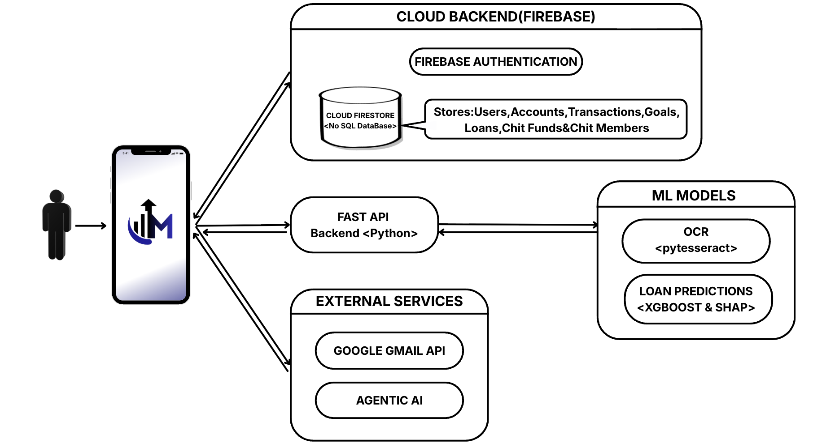
System Architecture

Slide 13
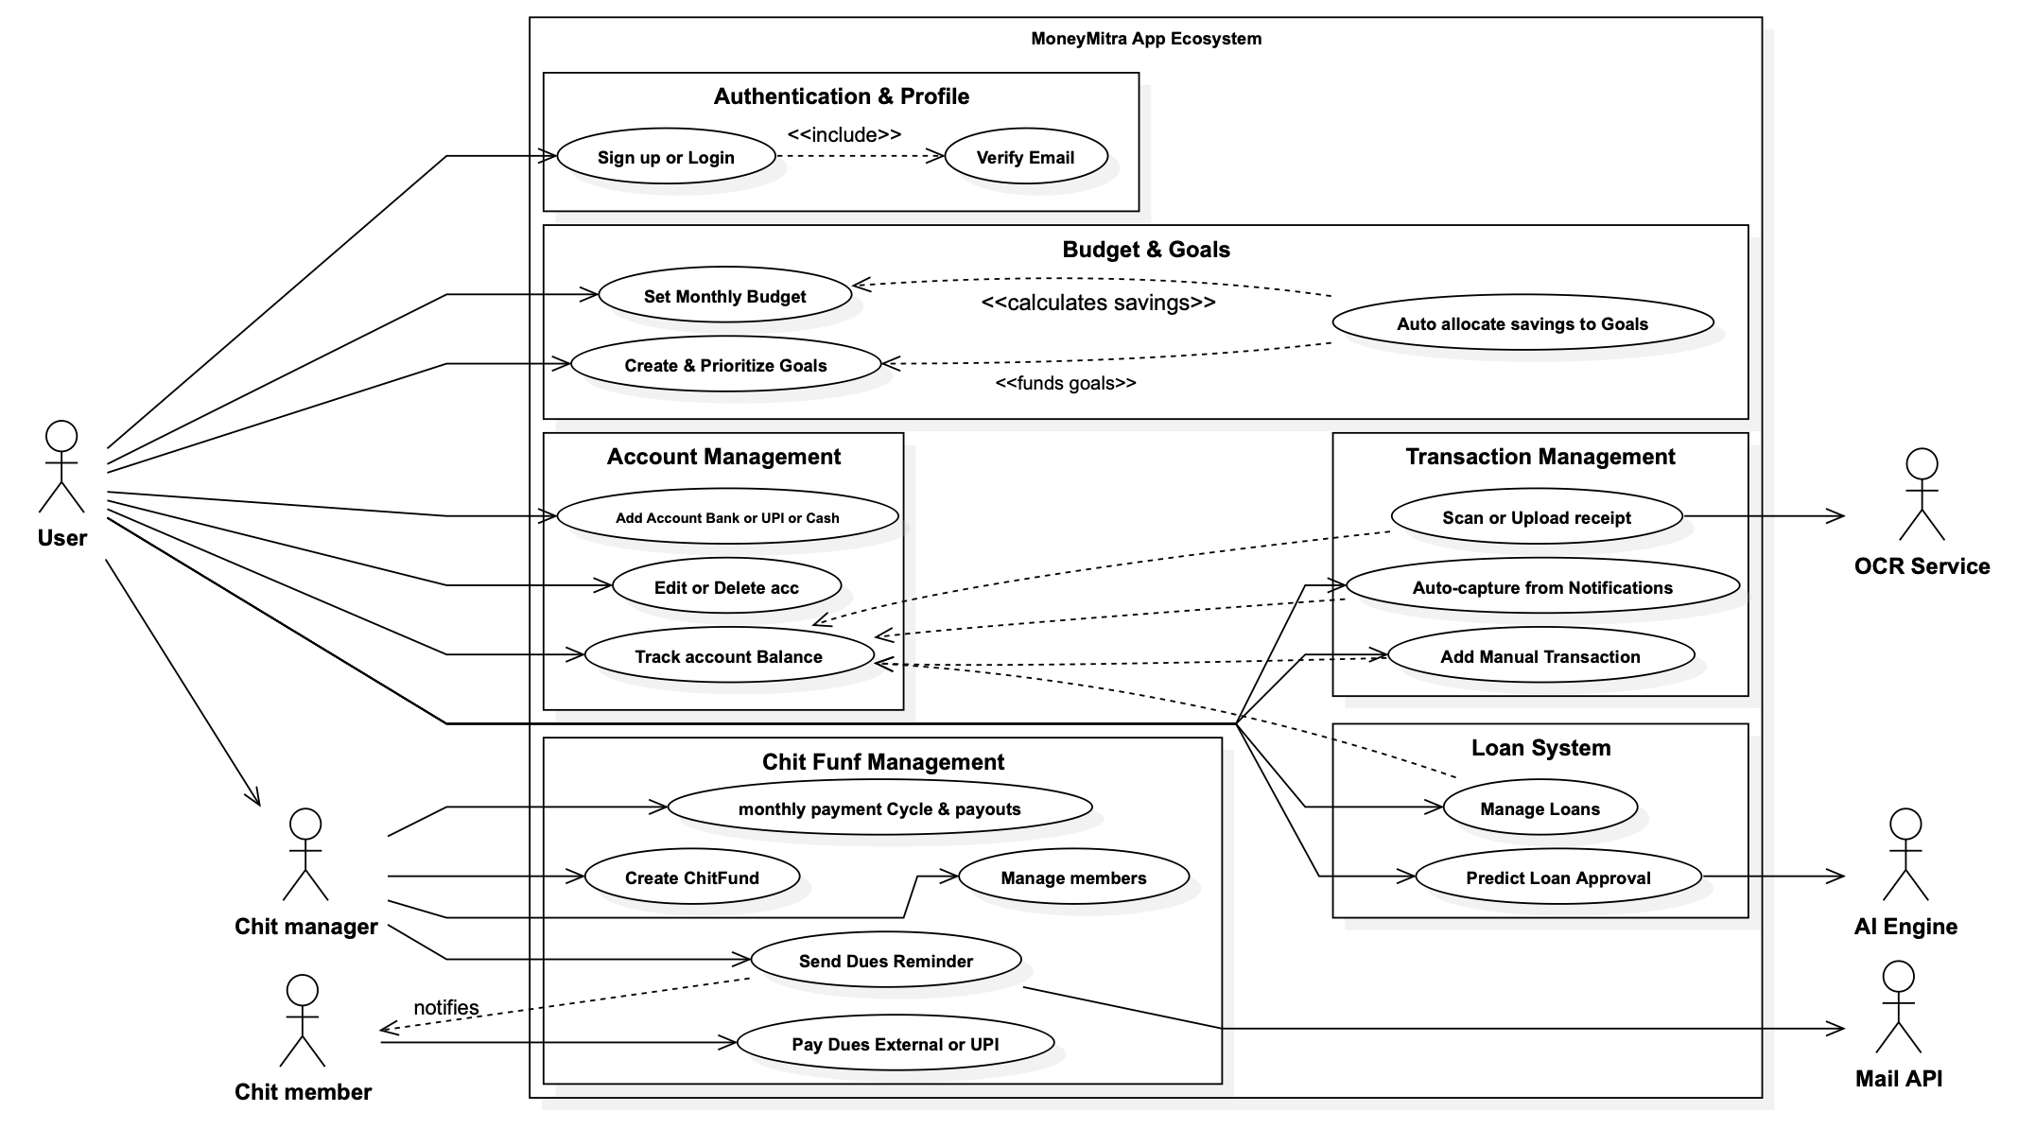
Use case Diagram

Slide 14
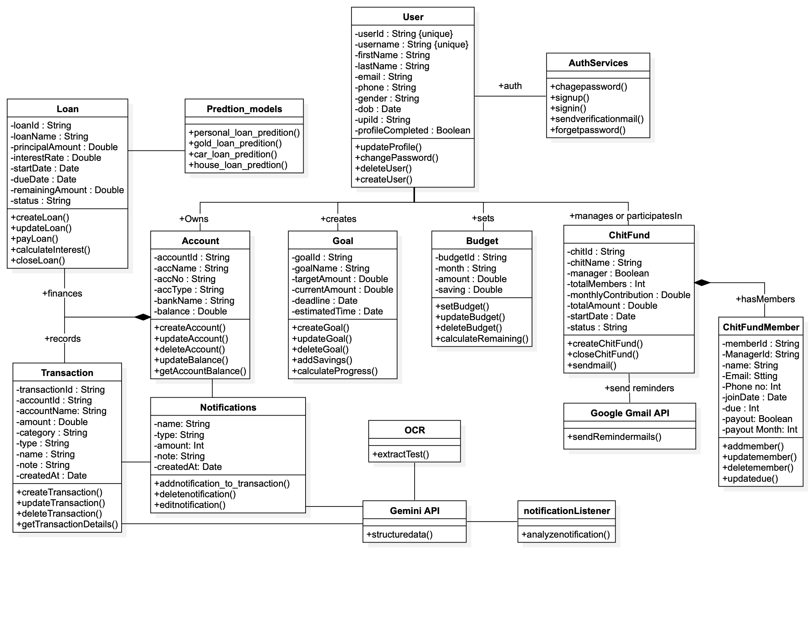
Class Diagram

Slide 15
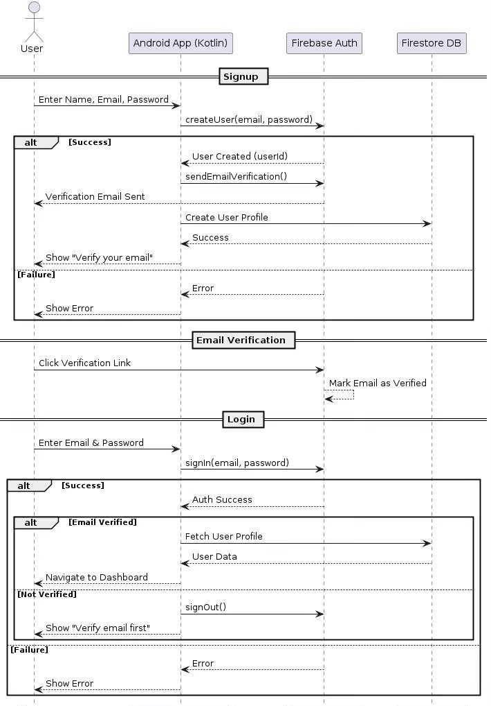
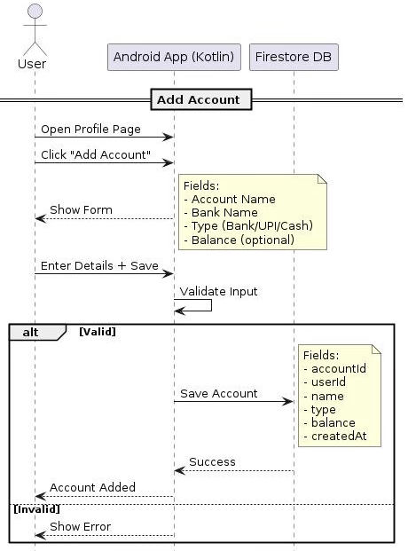
Sequence Diagram

Slide 16
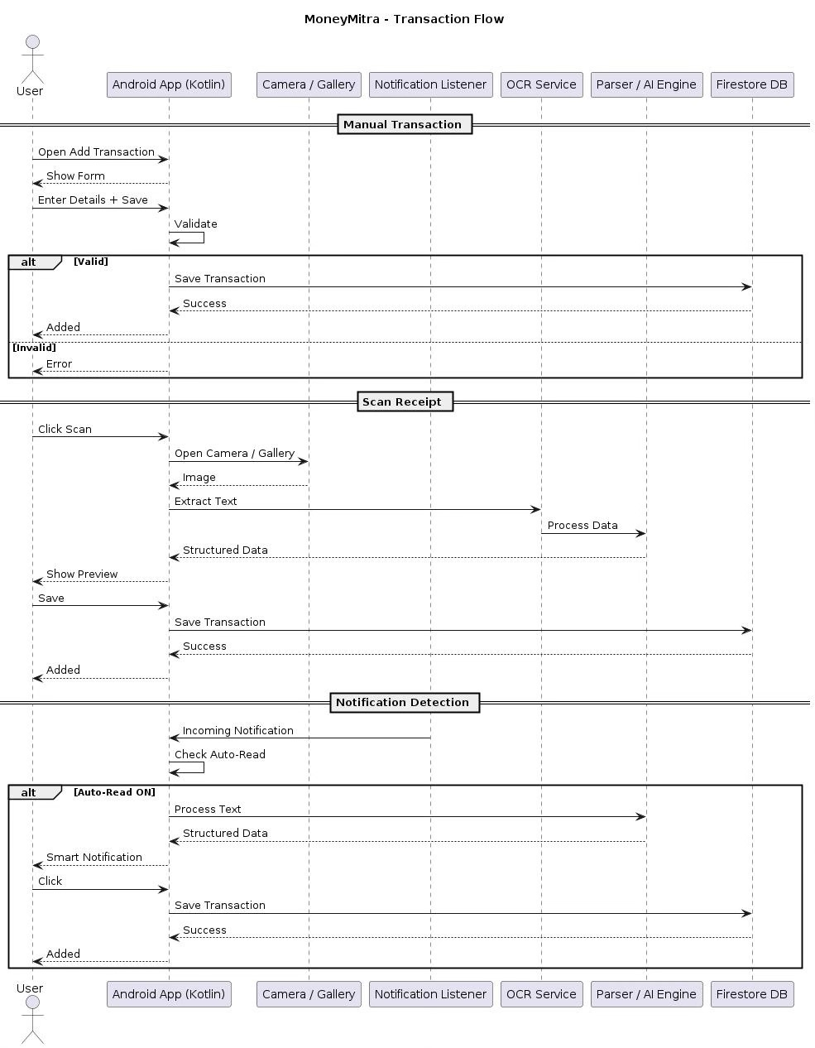
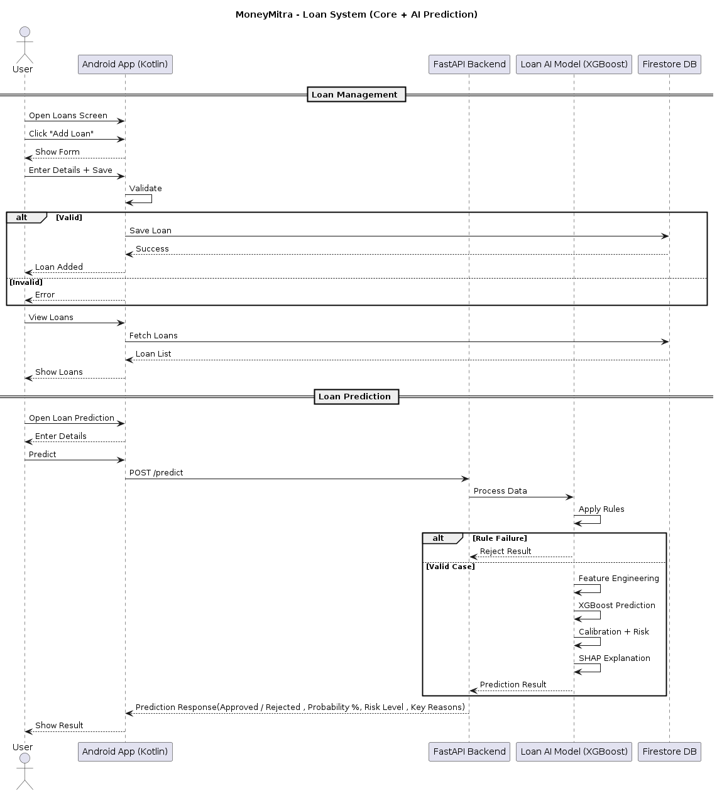
Sequence Diagram

Slide 17
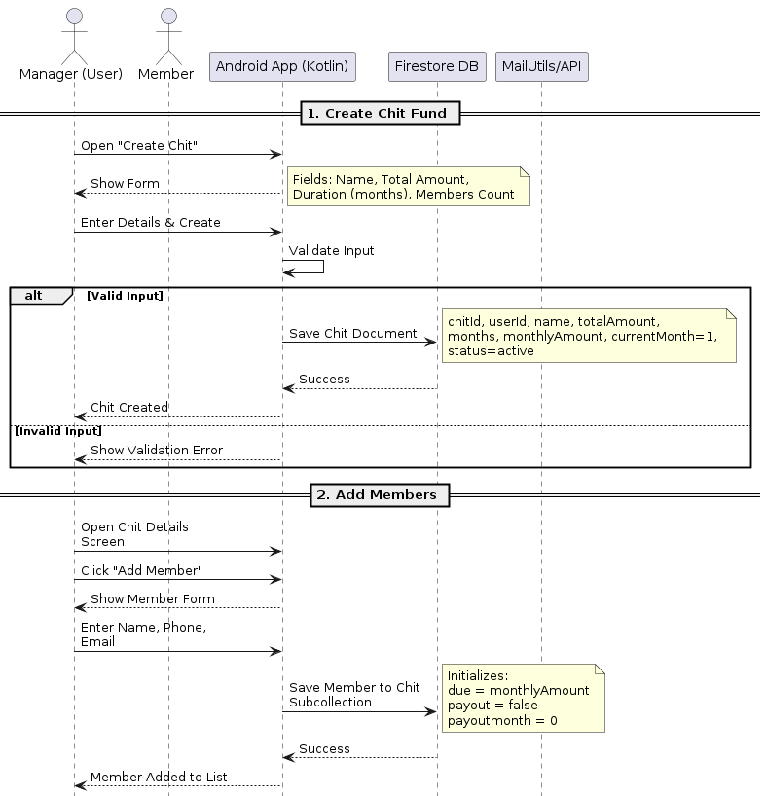
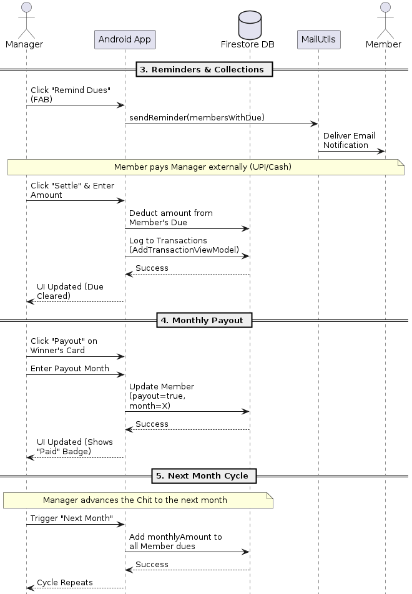
Sequence Diagram

Slide 18
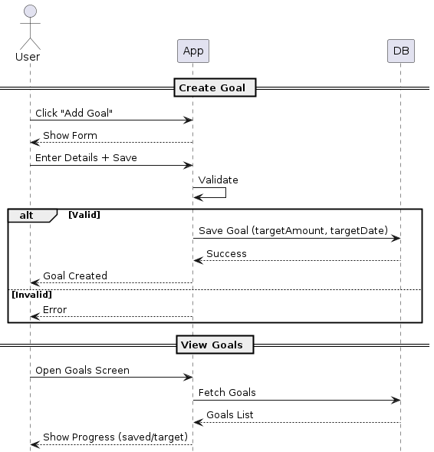
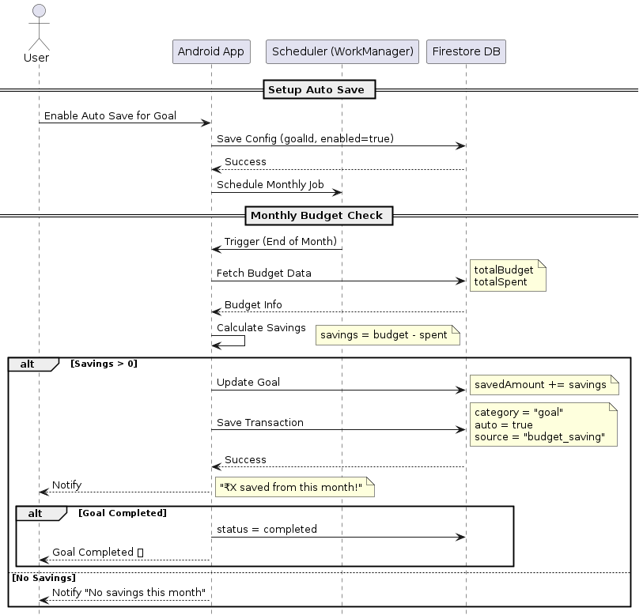
Sequence Diagram

Slide 19
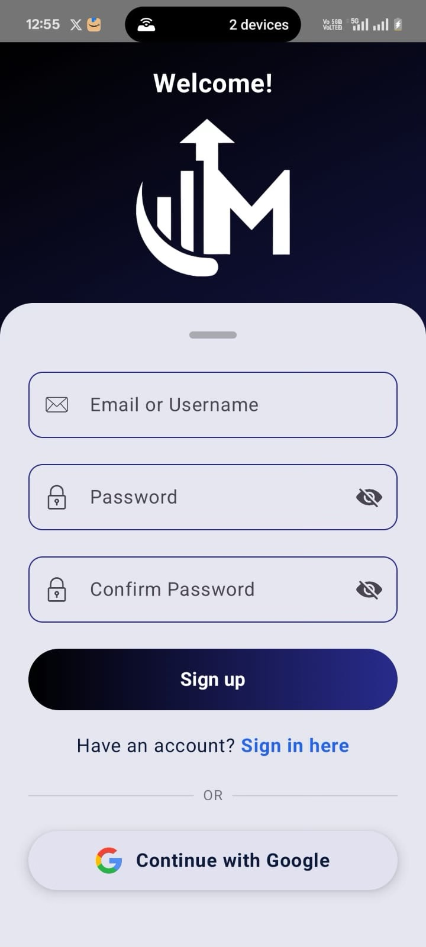
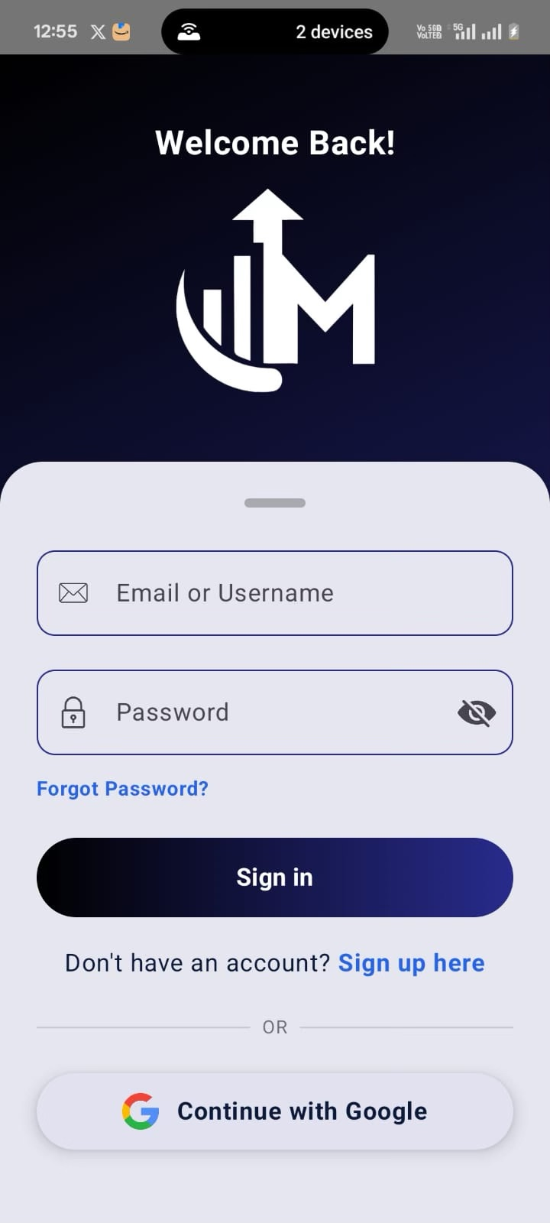
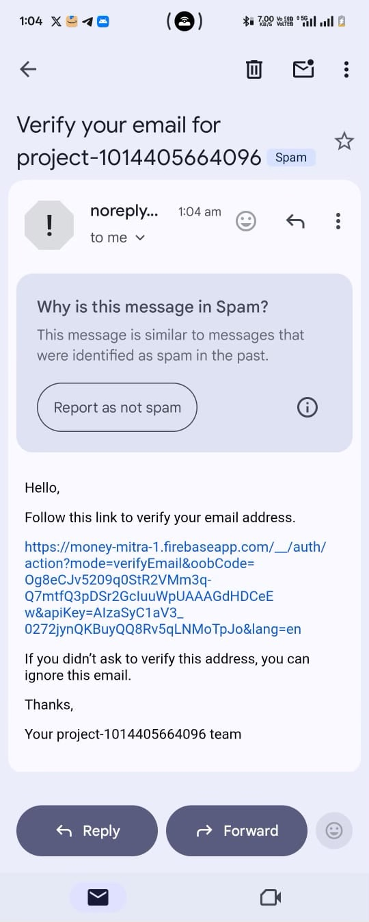
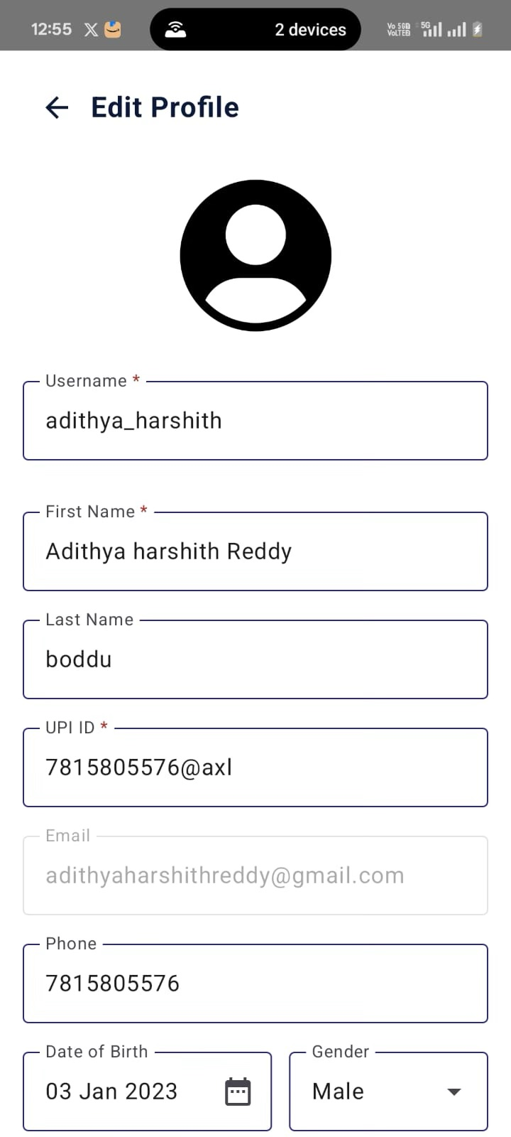
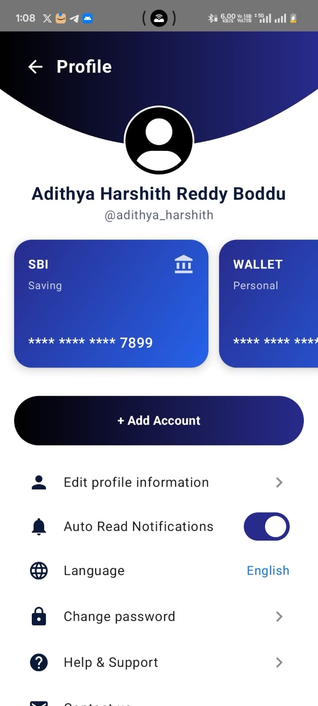
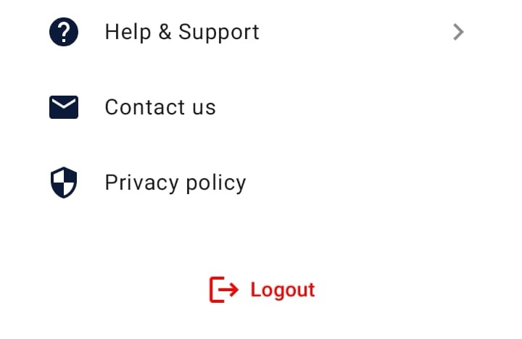
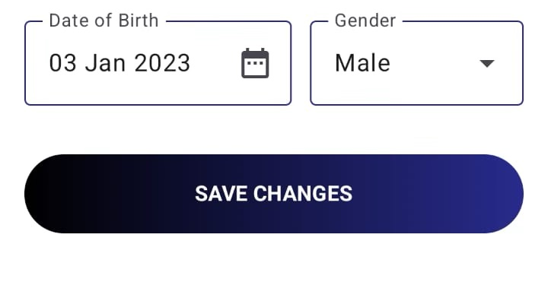
Implementation

Slide 20
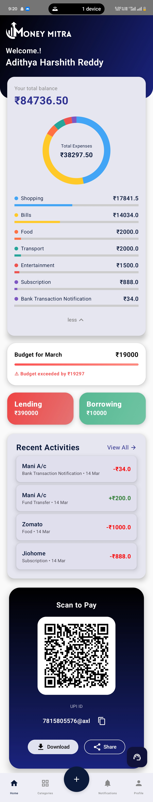
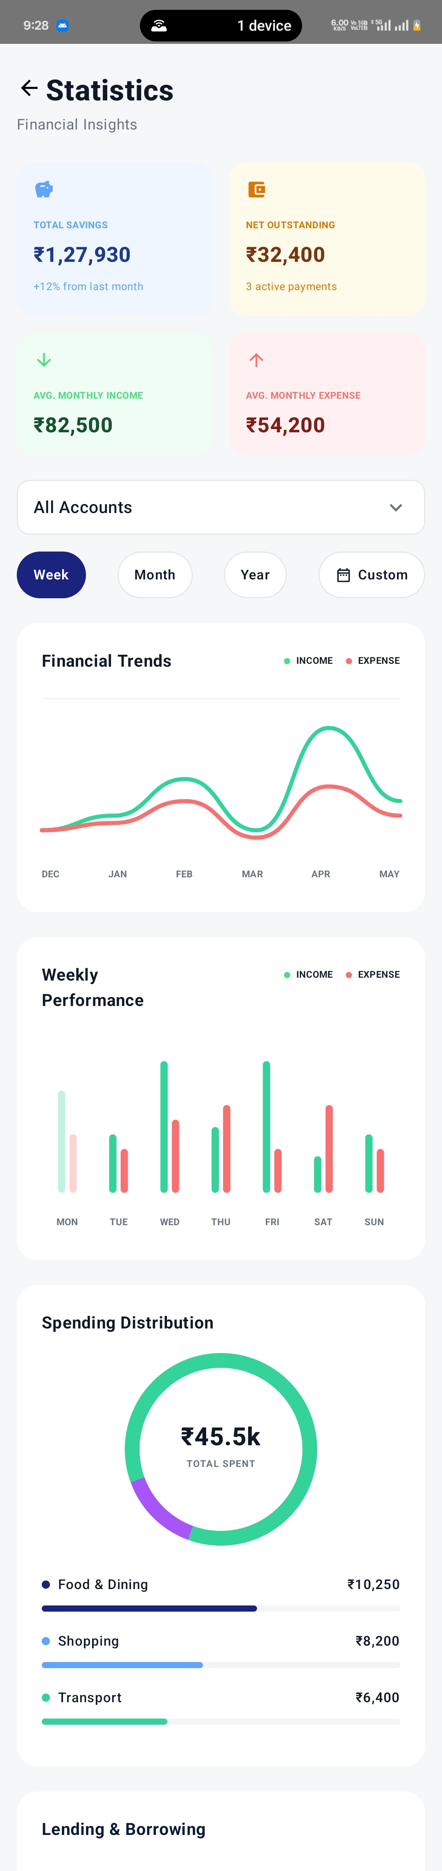
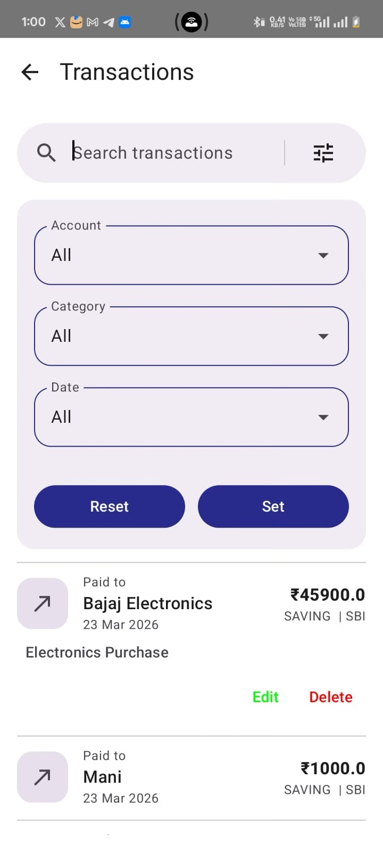
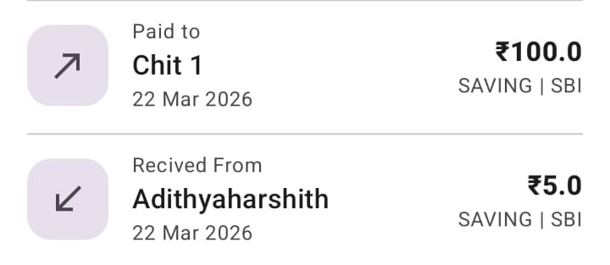
Implementation

Slide 21
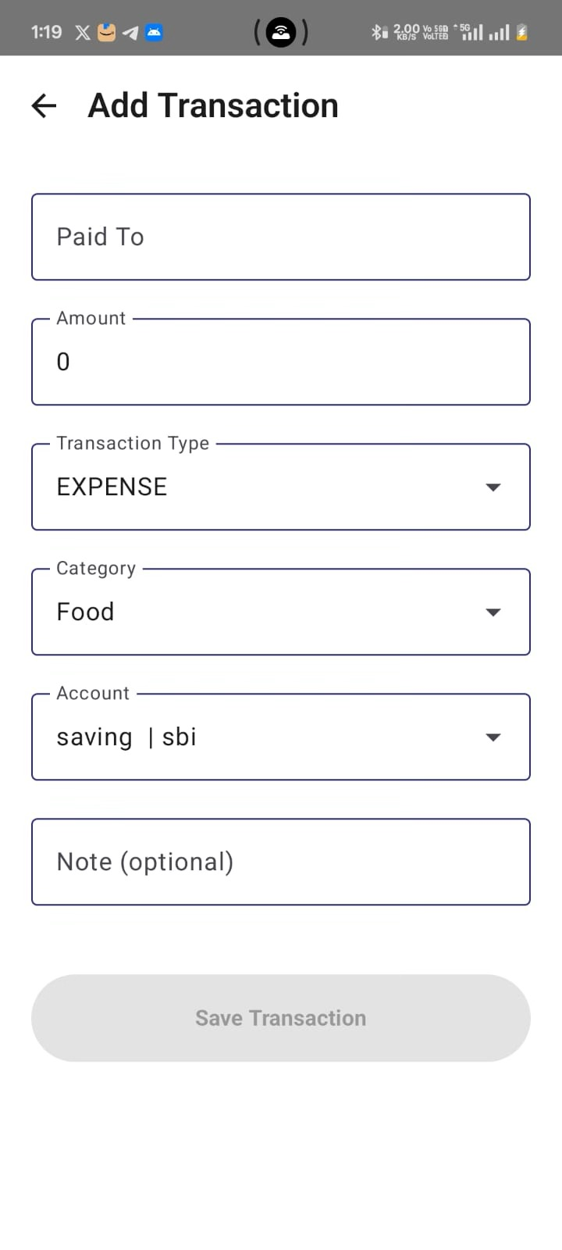
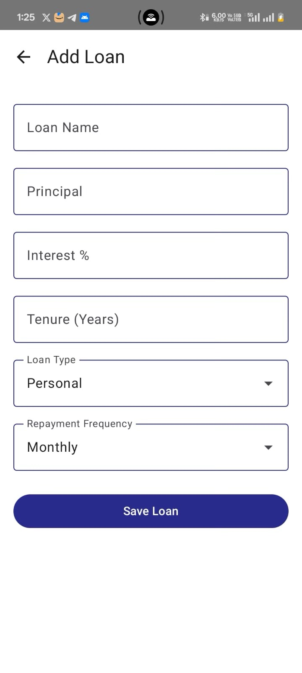
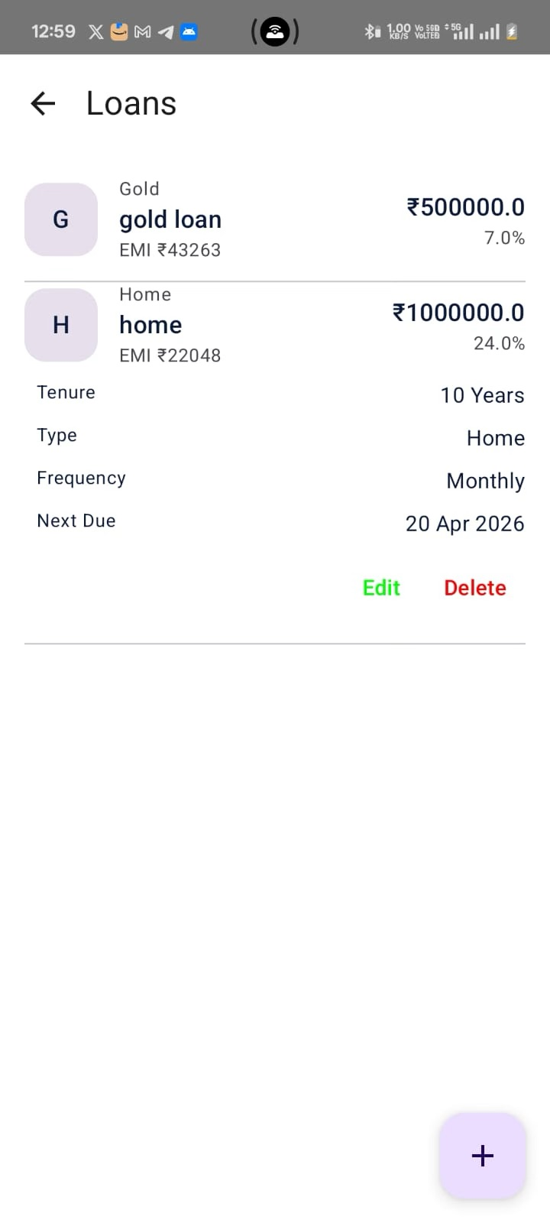
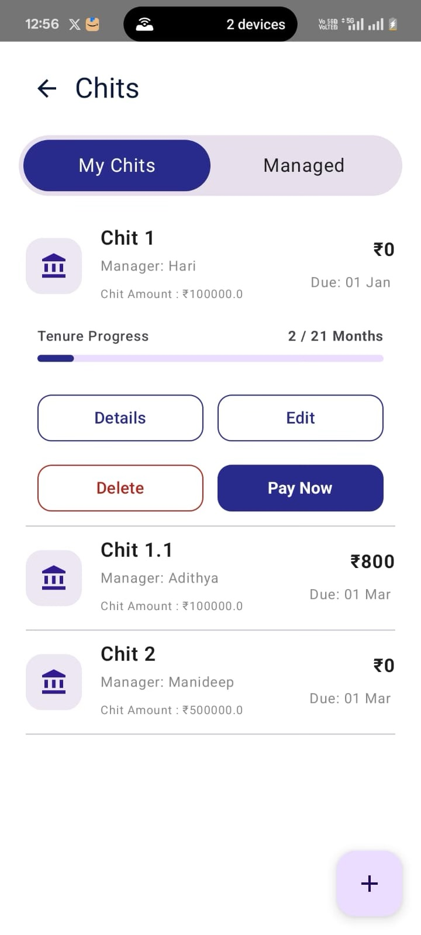
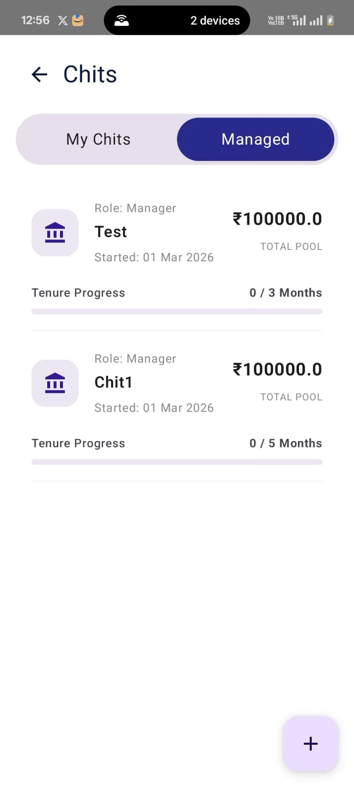
Implementation

Slide 22
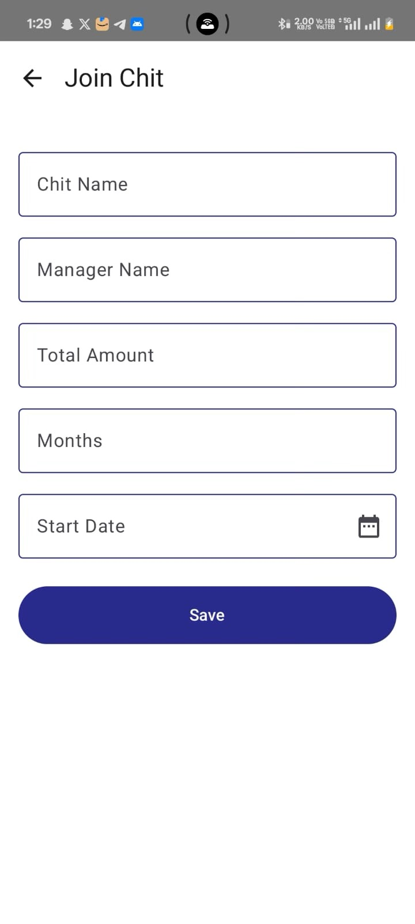
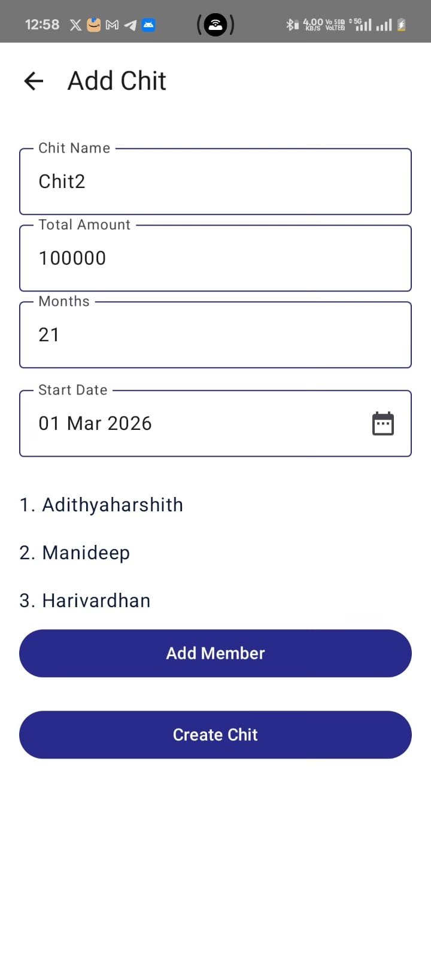
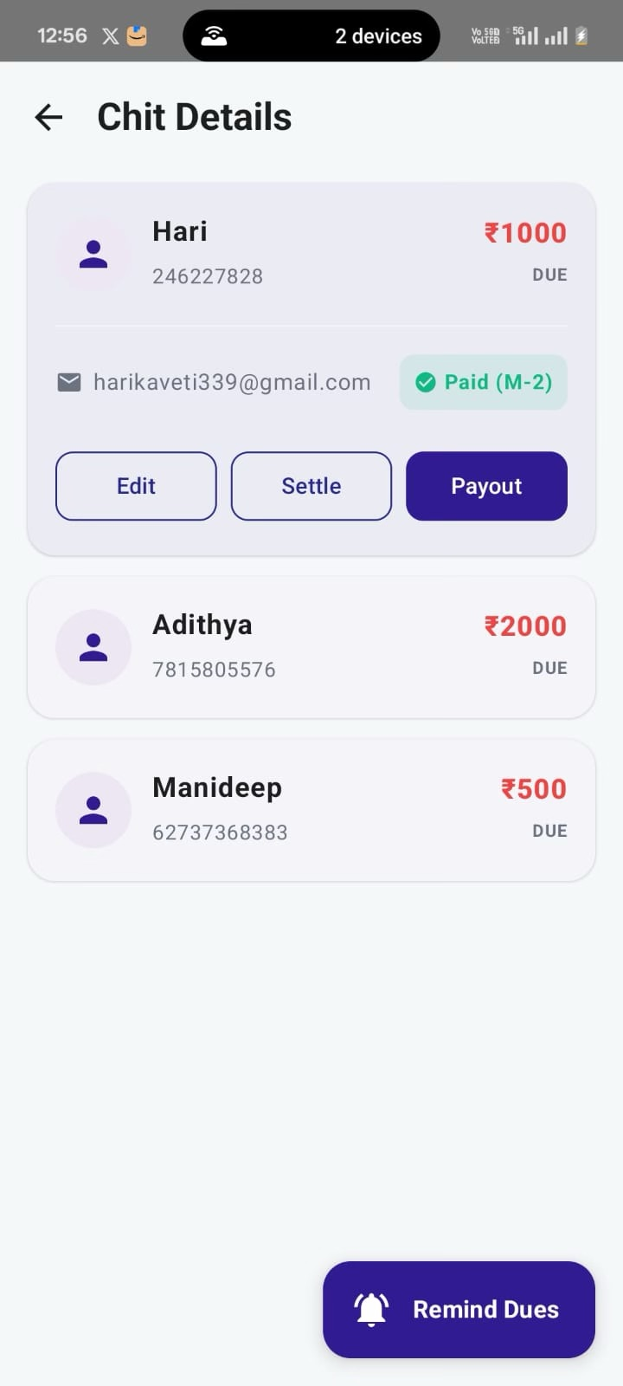
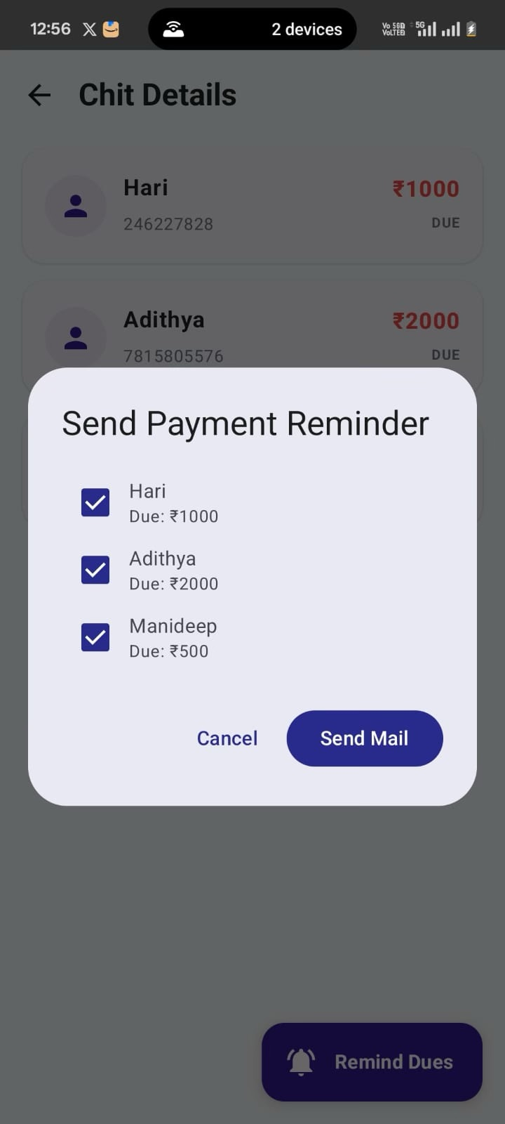
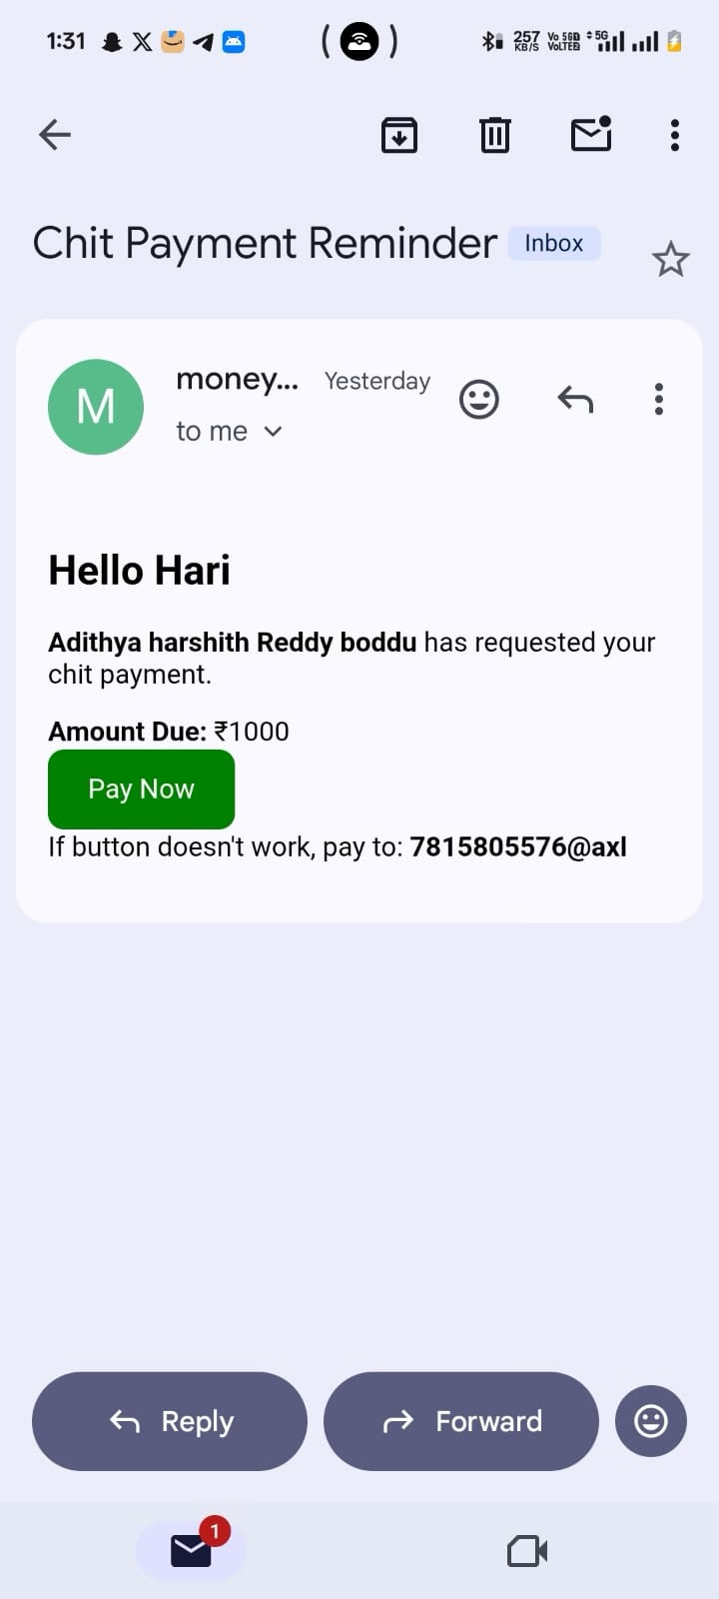
Implementation

Slide 23
Results
The implementation of Money Mitra successfully provides an integrated and intelligent financial management system.
• Accurate Transaction Tracking: Supports manual entry, OCR-based receipt scanning, and auto-read notification capture for reliable data collection. • Improved Financial Awareness: Users can monitor expenses, budgets, and multiple accounts effectively. • Efficient Goal Achievement: Enables goal-based savings with automated surplus allocation. • AI-Based Loan Insights: Provides loan eligibility prediction, risk analysis, and recommendations. • Chit Fund Management: Simplifies member tracking, collections, and payouts. • Real-time Notifications: Delivers timely alerts and financial insights for better decision-making.

Slide 24
Conclusion and Future Scope
Conclusion:
Money Mitra successfully provides an integrated and intelligent financial management platform by combining transaction tracking, budgeting, goal-based savings, AI-driven loan prediction, and chit fund management into a single system. The application enhances financial awareness, automates key processes such as transaction capture and savings, and supports users in making informed financial decisions through data-driven insights.
Future Scope:
• Integration with bank APIs for real-time transaction syncing • Advanced AI insights for spending analysis and investment suggestions • Multi-goal auto allocation and smart savings strategies • Cross-platform support (iOS and web) • Enhanced security features and document verification automation • Personalized financial advisory and credit score tracking

Slide 25
Thank You!!

